Slide 1
Predicting Risk of Subsequent Cardiovascular Events with a New Biomarker: Platelet FcɣRIIa
Schneider, D, McMahon, S, Angiolillo, D. et al. Platelet FcγRIIa as a Marker of Cardiovascular Risk After Myocardial Infarction. JACC. 2024 Oct, 84 (18) 1721–1729.

Slide 2
Disclosure
David J Schneider is named inventor on patents (US 10,502,737, US 11,747,335 B2) that propose the use of FcγRIIa for assaying platelet reactivity and treatment selection.
David J. Schneider is a co-founder of Prolocor, which is developing the platelet FcγRIIa test for clinical use.

Slide 3
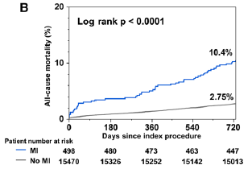

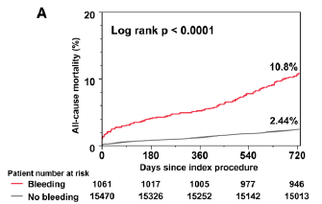
Balancing Risk of Thrombosis and Bleeding
2-Year Mortality: MI after PCI
2-Year Mortality: BARC Bleeding
(2,3,5) After PCI
Hara H, et al. Circ Cardiovasc Interv. 2020 Sep;13(9):e009177.

Slide 4
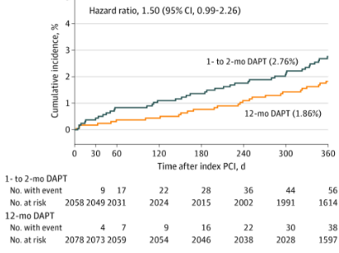
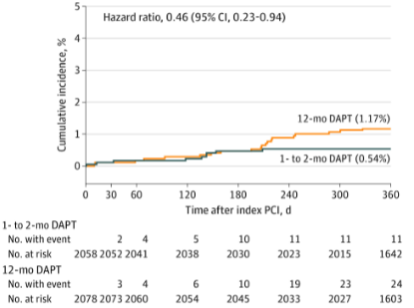
Early De-Escalation: Trading Less Bleeding for More Ischemic Events
STOPDAPT-2 ACS
Cardiovascular Events*
Bleeding Events**
*cardiovascular death, myocardial infarction, definite stent thrombosis, or any stroke
**Thrombolysis in Myocardial Infarction major or minor bleeding
Watanabe H, et al JAMA Cardiol 2022;7:407-417

Slide 5
High Platelet Reactivity
Predicts a Greater Risk of Cardiovascular (CV) Events after PCI
Clinical Outcomes Based on Platelet Reactivity
Platelet Function Test | On Treatment Reactivity |  | OR | p value
 | Low | High
LTA 5 µM ADP | <42.9% (n=604) | ≥42.9% (n=445)
CV Events | 6% | 11.7% | 2.09 (1.34-3.25) | <0.001
LTA 20 µM ADP | <64.5% (n=659) | ≥64.5% (n=392)
CV Events | 6.2% | 12% | 2.05 (1.32-3.19) | <0.001
VerifyNow P2Y12 | <236 PRU (n=646) | ≥236 PRU (n=406)
CV Events | 5.7% | 13.3% | 2.53 (1.63-3.91) | <0.001
Plateletworks | <80.5 (n=344) | ≥80.5 (n=262)
CV Events | 6.1% | 12.6% | 2.22 (1.25-3.93) | 0.005
CV Events - cardiovascular events that includes death, myocardial infarction or stroke
LTA - light transmission aggregometry
1,069 patients, Elective PCI, 1 yr follow-up
CV Event Rates:
Low Platelet Reactivity ~6%
High Platelet Reactivity ~12%
Platelet Function tests: consistently (more than 100 prospective randomized studies including more than 22,000 patients) identify patients at greater risk of ischemic events
Breet et al. JAMA 2010;303:754-762.

Slide 6
Challenges of Platelet Function Tests
Platelets are Activated In Vitro
Phlebotomy can lead to activation of platelets (can change results)
Anticoagulant influences platelet activation (can change results)
Activation in response to a single agonist or group of agonists
  No consensus on optimal agonist(s)
Concentration of agonist must be selected
  No consensus on optimal concentration
Platelet function is highly variable
  Variation is seen during the course of 1 day
  Analogy: Defining treatment based on platelet function tests is like defining treatment based on a random glucose test

Slide 7
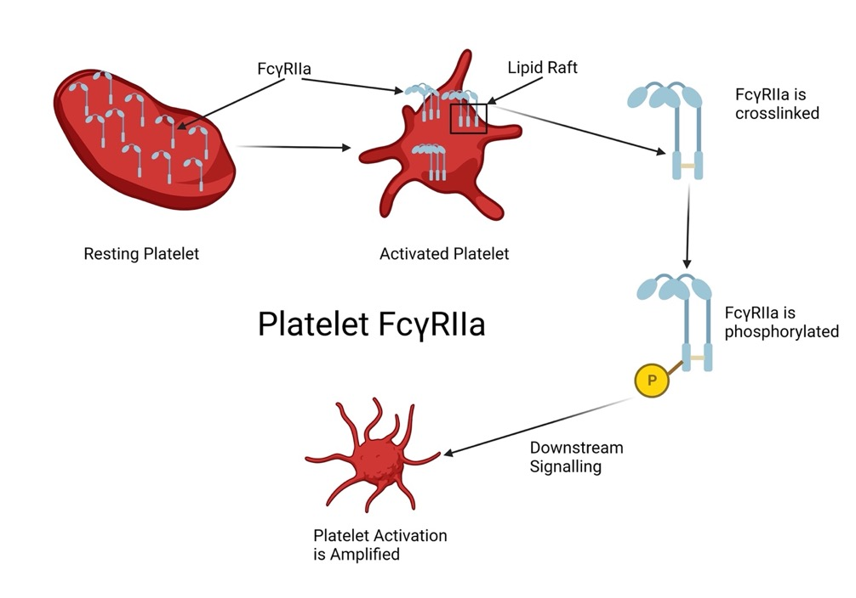
A New Cardiovascular Risk Marker: Platelet FcγRIIa (pFCG)
pFCG expression predicts high or low risk of cardiovascular events (death, MI, stroke)
pFCG
was first described almost 40 years ago as an immunoreceptor
more recently a second function was identified, it plays a key role in amplification of platelet activation and aggregation
  is expressed on the surface of platelets and during early activation translocates into ‘lipid rafts’ (clusters)
  FCG is then crosslinked and phosphorylated
  is an important conduit in signaling mediated by other platelet receptors, including integrins’ ‘outside-in’ signaling
  Greater expression leads to greater activation in response to any agonist/stimulus
Lopez JA. Blood 2013;121: 1674–5.

Slide 8
Platelet FcɣRIIa (pFCG) Test
Leverages the prognostic implications of increased platelet reactivity
  More than 100 studies and >22,000 patients
pFCG Test quantifies FCG on fixed platelets
  Limited manipulation of platelets (not a functional test)
  FCG quantified with flow cytometry, which enhances precision
    Results from 10,000 platelets obtained in ~1 minute
  Duplicate test variation 2-5%
  FCG Test can be performed up to 5 days after phlebotomy with variation of 5-10%
pFCG Test avoids challenges of platelet function tests
  Phlebotomy and anticoagulant do not influence results.
  No agonist
  Megakaryocyte production defines platelet FCG during the life of a platelet (~7 days)
  Treatments (e.g. antiplatelet drugs) that change platelet function don’t influence pFCG test

Slide 9
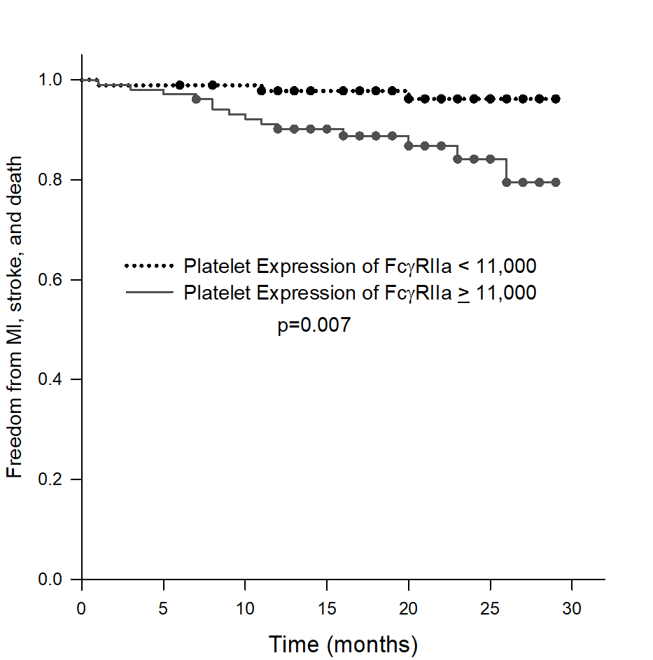
pFCG discriminates high and low risk of CVE
Single-center Study: Assess Ability of pFCG to Identify Risk of CVE
Single center, 197 patients with MI, average follow-up 20 months
Hypothesis: Platelet FcγRIIa amplifies platelet activation, identifies increased platelet reactivity, thus, increased CV risk
Patients with known higher risk of cardiovascular events (older, with diabetes or previous revascularization) had higher pFCG
High expression of pFCG compared to low was associated with
  greater risk of D/MI/stroke (12.5% vs 3.2%, OR 4.3, 95% CI 1.18-15.6, p=0.027)
  greater risk of D/MI/revasc/stroke (17.3% vs 6.5%, OR 3.2, 95% CI 1.23-8.51, p=0.017)
  pFCG was the sole covariate (hazard ratio 3.9, p=0.035) associated with freedom from MI, stroke, and death.
Low pFCG
High pFCG
Schneider DJ, et al, J Am Coll Cardiol 2018;72:27-9.
Schneider DJ, et al. Am J Cardiol 2020;125:670-2.

Slide 10
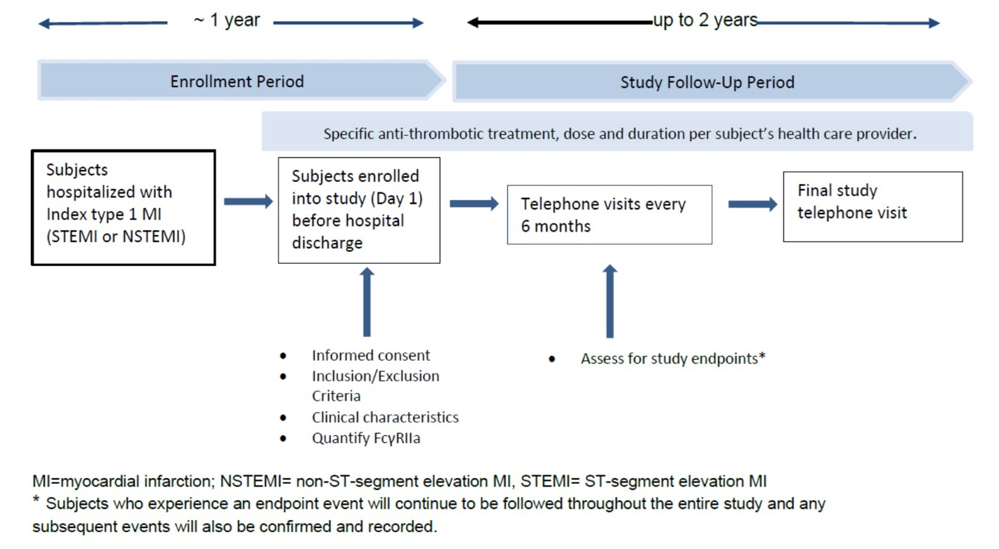
Multicenter Study to Validate Prognostic Implications of pFCG Test
Trial Design
800 patients, 25 centers
Enrolled patients had at least 2 of the following: age ≥ 65, multi-vessel coronary artery disease, prior MI, chronic kidney disease, or diabetes mellitus.
Primary endpoint = composite of MI, stroke, and death

Slide 11
Multicenter Validation Study: Clinical Characteristics
Characteristic | All Patients (n=764) | Low pFCG (n=547) | High pFCG (n=217) | p
Age (mean ± SD) | 69 ± 10 | 69 ± 10 | 69 ±10 | 0.847
Gender (% male) | 68% (519) | 68% (372) | 67% (145) | 0.932
MI Type
STEMI | 29% (222) | 29% (159) | 29% (63) | 0.930
NSTEMI | 71% (542) | 71% (388) | 71% (154) | 0.930
HTN | 87% (665) | 86% (470) | 89% (173) | 0.288
DM | 57% (435) | 57% (312) | 59% (128) | 0.686
insulin treatment | 26% (199) | 24% (131) | 30% (65) | 0.120
Active Smoker | 22% (168) | 23% (125) | 19% (41) | 0.284
Hyperlipidemia | 74% (565) | 74% (404) | 76% (165) | 0.521
Prior MI | 28% (214) | 26% (142) | 32% (69) | 0.108
Prior CABG | 14% (107) | 12% (66) | 17% (37) | 0.078
Prior PCI | 36% (275) | 36% (197) | 35% (76) | 0.802
PAD | 12% (92) | 11% (59) | 15% (33) | 0.083
Prior stroke | 10% (76) | 8% (44) | 14% (30) | 0.021
Chronic Kidney Disease
GFR <60 | 31% (237) | 28% (153) | 39% (84) | 0.006
ESRD | 4% (30) | 2% (11) | 7% (15) | 0.003
Characteristic | All Patients (n=764) | Low pFCG (n=547) | High pFCG (n=217) | p
Medications
Aspirin | 93% (711) | 93% (509) | 93% (202) | 1.000
Clopidogrel | 55% (420) | 57% (312) | 52% (113) | 0.227
Ticagrelor | 24% (183) | 25% (137) | 22% (48) | 0.511
Prasugrel | 7% (53) | 6% (33) | 8% (17) | 0.348
Anticoagulant | 14% (107) | 14% (77) | 14% (30) | 0.908
β-blocker | 88% (672) | 88% (481) | 89% (193) | 0.625
CCB | 21% (160) | 20% (109) | 24% (52) | 0.282
nitrates | 33% (242) | 34% (186) | 30% (651) | 0.393
ACEI/ARB | 55% (91) | 55% (43) | 54% (48) | 0.850
diuretic | 39% (22) | 37% (6) | 42% (16) | 0.217
Lipid Lowering | 94% (718) | 95% (519) | 92% (199) | 0.134
Schneider D et al JACC 2024 Oct, 84 (18) 1721–1729.

Slide 12
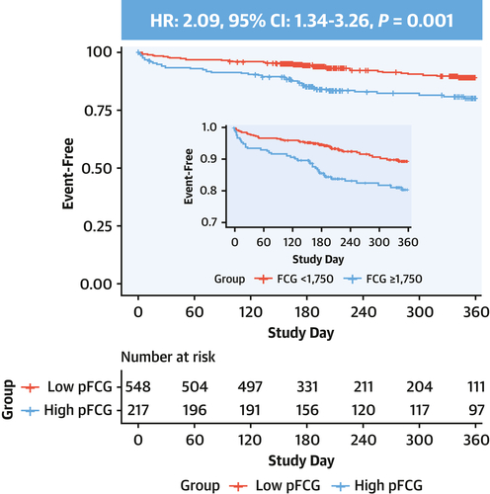
Validation Study: Primary Endpoint, Freedom from MI, Stroke, Death
Schneider D et al JACC 2024 Oct, 84 (18) 1721–1729.

Slide 13
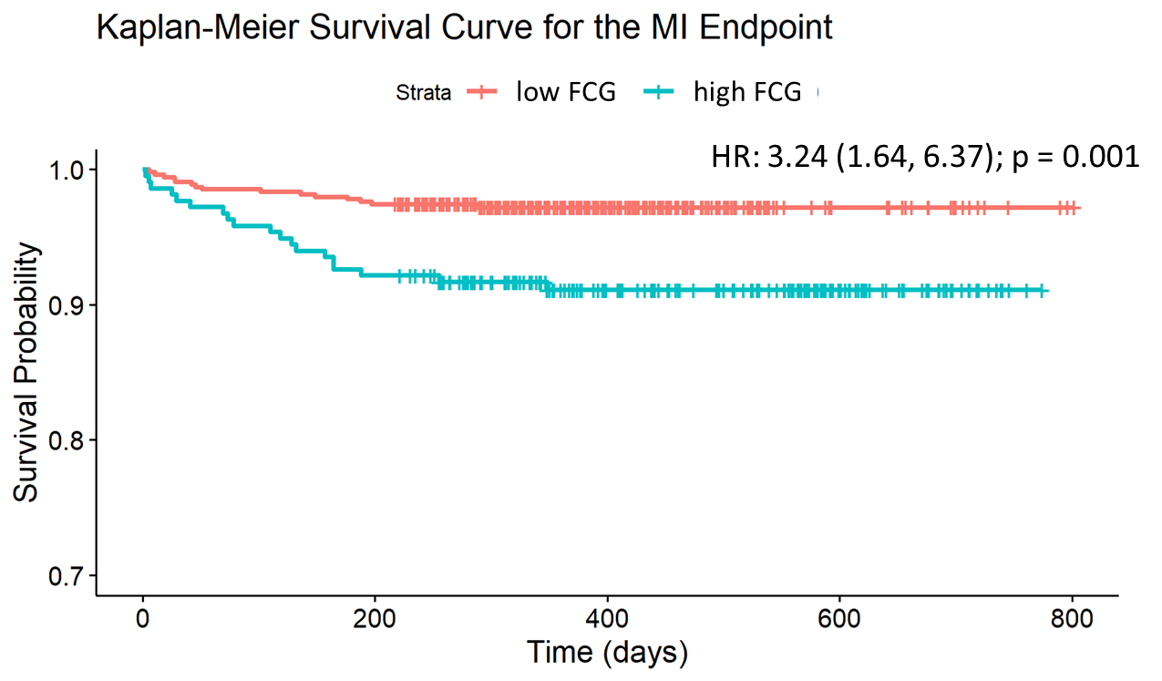
Validation Study: HR for Components of the Primary Endpoint
Endpoint | HR | 95% CI | p value
Composite | 2.09 | 1.34-3.26 | 0.001
MI or Death | 2.71 | 1.73-4.25 | <0.001
MI | 3.24 | 1.64-6.37 | <0.001
Death | 2.57 | 1.50-4.40 | <0.001
Stroke | 0.83 | 0.17-4.12 | 0.823
Schneider D et al JACC 2024 Oct, 84 (18) 1721–1729.

Slide 14
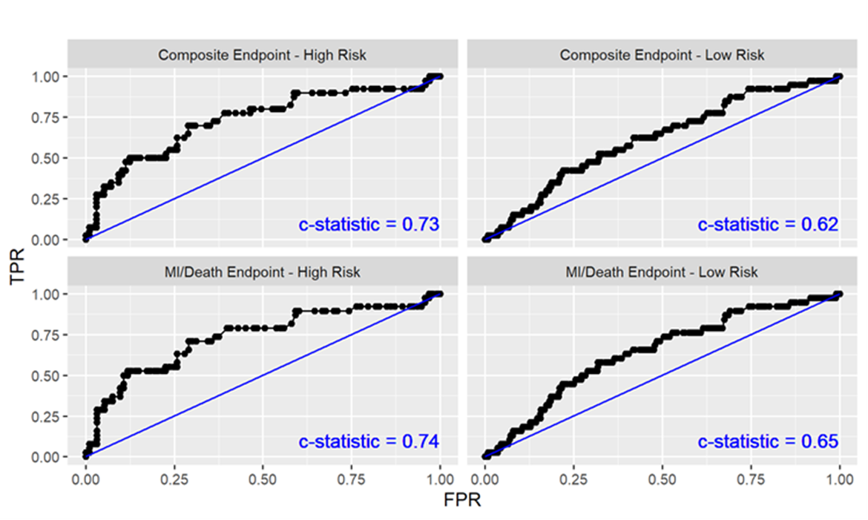
Additive Value of the pFCG Test to Clinical Risk
Based on Clinical Risk, Composite Endpoints: Low Risk = 6.2% High Risk = 29.2%
pFCG test is capable of discriminating higher and lower risk among patients deemed to be at
high risk based on clinical characteristics.
Schneider D et al JACC 2024 Oct, 84 (18) 1721–1729.

Slide 15
Validation Study: Multivariate Analysis, Bleeding Endpoints
Bleeding events (BARC > n=31) tended to be more frequent in patients with high pFCG
In multivariate analysis no characteristic was associated with a greater risk of bleeding.
 | Univariate Analysis |  | Multivariate Analysis
Characteristic | HR | p | HR | p
High pFCG | 1.84 | 0.095 | 1.73 | 0.138
Age>65 | 1.06 | 0.876 | 1.06 | 0.891
Hypertension | 1.58 | 0.447 | 1.38 | 0.600
ESRD | 1.95 | 0.360 | 1.51 | 0.583
Prior Stroke | 2.66 | 0.031 | 2.17 | 0.097
Schneider D et al JACC 2024 Oct, 84 (18) 1721–1729.

Slide 16
Summary
pFCG identifies patients with MI who are at high and low risk of subsequent cardiovascular events (particularly MI and death)
The low-risk cohort is 50-70% of patients with MI
pFCG is an independent predictor of risk and can discriminate high and low risk when applied to clinical risk scores
Among patients with MI treated with PCI, the low risk pFCG stratum has a very low risk of MI during 1 year of follow-up
Schneider D et al JACC 2024 Oct, 84 (18) 1721–1729.

Slide 17
Conclusions
The pFCG test has been shown to identify patients with MI who are at high and low risk of subsequent cardiovascular events in 2 separate studies:
  The pFCG test is a validated prognostic tool to discriminate risk.
When clinicians are considering early de-escalation of DAPT, the pFCG test can provide meaningful information to assist decision making.
Schneider D et al JACC 2024 Oct, 84 (18) 1721–1729.

